Slide 1
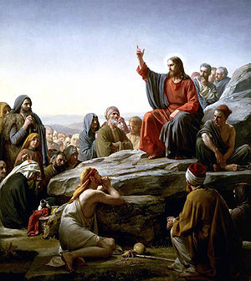
The Intertestamental Period: From Babylon To The Birth Of Christ
Greek Period

Slide 2
Intertestamental Period
Week | Date | Topic
1 | 01 Mar 17 | Overview
2 | 08 Mar 17 | Babylonian Period (605-539 BC)
3 | 15 Mar 17 | Persian Period (539-332 BC)
4 | 22 Mar 17 | Greek Period (332-323 BC)
5 | 29 Mar 17 | Ptolemaic (323-198 BC)
6 | 05 Apr 17 | Seleucid (198-168 BC)
7 | 12 Apr 17 | Maccabean Part 1 (168-153 BC)
8 | 19 Apr 17 | Maccabean Part 2 (153-139 BC)
9 | 26 Apr 17 | Independence (139-63 BC)
10 | 03 May 17 | Rome Intervenes (63 – 37 BC)
11 | 10 May 17 | Herod (37 BC – 4 BC)
12 | 17 May 17 | The IT Period and Christianity (4 BC – 70 AD)
13 | 24 May 17 | Review
Notes:
Week 1 - Overview Week 2 - Babylonian Period (605-539 BC) Week 3 - Persian Period (539-332 BC) Week 4 - Greek Period (332-323 BC) Alexander 332 - 323 Week 5 - Ptolemaic (323-198 BC) Ptolemy and Egypt 320 – 198
Week 6 - Syrian (198-168) Seleucid and Syria 198 - 168 Week 7 - Maccabean Period Part 2 (167-143) Mattathias 167 - 166
Judas the Maccabee 166 - 160 Jonathan 160 - 143 Week 8 - Independence (142 - 63)
Simon 143 - 134 John Hyrcannaus 134 – 105
Aristobulus 104 - 103 Alexander Jannaus 103 - 76 Alexander Salome 76 - 67 Hyrcanus II and Aristobulus II 67-63 Week 10 – Rome Intervenes (63 – 37 BC)
Week 11 – Herod (37-4 BC) Week 12 – Intertestamental period and Christianity (4 BC – 70 AD) Week 13 - Review

Slide 3
Today’s Objectives
Review last week’s lesson
Review the transition of power between Persians and the Greeks
Review key Biblical scriptures
Learn about the political, social, economic, cultural, and religious issues during the Greek rule over Israel
Learn about Alexander's impact on the Mediterranean and Asian regions
Learn about the transition of the Greek empire
Notes:
3
Alexander the Great saw the Jewish people as blessed. His first encounter with them was in a dream according to historians of the time. Essentially, his fascination was with the monotheistic religion of the Jews against the Greek belief of many gods. The Greeks believed in 12 main gods and goddesses. Among these are Zeus, Poseidon, Hades, Apollo, and Athena. These are called Olympian gods. There are hundreds of minor gods.
During his military campaign against Persia, Alexander’s invasion turned south, conquering Tyre and then Egypt via what is today Israel. Historians record Alexander's first encounter with the Jews of Israel, who were subjects of the Persian Empire.
The narrative concerning Alexander's first interaction with the Jews is recorded in both the Talmud (Yoma 69a) and in the Jewish historian Josephus's Book of Antiquities (XI, 321-47). In both accounts the High Priest of the Temple in Jerusalem, fearing that Alexander would destroy the city, went out to meet him before he arrived at the city. The narrative describes how Alexander, upon seeing the High Priest, dismounted and bowed to him. (Alexander rarely, if ever, bowed to anyone). In Josephus's account, when asked by his general, Parmerio, to explain his actions, Alexander answered, "I did not bow before him, but before that God who has honored him with the high Priesthood; for I saw this very person in a dream, in this very apparel."
Alexander interpreted the vision of the High Priest as a good omen and thus spared Jerusalem, peacefully absorbing the Land of Israel into his growing empire. As tribute to his benign conquest, the Sages decreed that the Jewish firstborn of that time be named Alexander -- which remains a Jewish name to this very day. And the date of their encounter, the 25th of Tevet, was declared a minor holiday.
Thus began one the most interesting and complex cultural relationships in the ancient world. The Greeks had never met anyone like the Jews, and the Jews had never met anyone like the Greeks. The initial interaction seemed to be very positive. To the Jews, the Greeks were a new and exotic culture from the West. They had a profound intellectual tradition that produced philosophers such as Socrates, Plato, and Aristotle (who was Alexander's tutor for two years). Their love of wisdom, science, art, and architecture set them apart from other cultures the Jews had interacted with. The Greek language was considered so beautiful that the Talmud called it in some ways the most beautiful of all languages and the Rabbis decreed that a Torah scroll could even be written in Greek.
The Greeks had never met anyone like the Jews -- the world's only monotheistic nation who had a unique concept of a loving, infinite God who cares about creation and acts in history. The Jews had incredibly profound and complex legal and philosophical traditions. They had literacy rates and a social welfare infrastructure unheard of in the ancient world. So fascinated were the Greeks with the Jews that they became the first people to translate the Bible into another language when King Ptolemy II (c. 250 BC) forced 70 Rabbis to translate the Hebrew Bible into Greek (known as the Septuagint, which means "70" in Greek).
(Rabbi Spiro)

Slide 4
Last week’s lesson
Reviewed last week’s lesson
Reviewed the transition of power between Babylon and the Persians
Reviewed key Biblical scriptures
Learned about the political, social, economic, cultural, and religious issues during the Persian rule over Israel
Learned where and why all the Israelites did not return to Judah
Learned about the fall of the Persian empire

Slide 5
Reference Material
KJV (w/ Apocrypha)
1st and 2nd Maccabbees
Josephus – The Complete Works
Herodotus – The History
Intertestamental History – Mark Moore
Ancient Rome – Simon Baker
Harding University – BNEW 112 Course Notes – Dr. Thompson

Slide 6
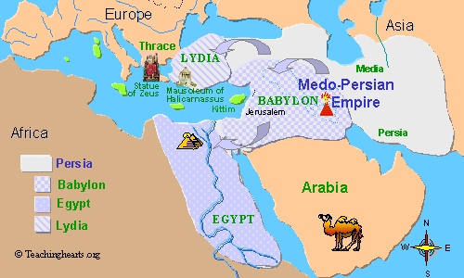
Persian Empire

Slide 7
Greek Rule 1 of 3
Alexander was the son of Philip of Macedon
Alexander claimed paternal descent from Heracles and maternal descent from Achilles
Philip was a very capable General and administrator
Forced the independent and warring city-states of Macedonia and Greece proper into a national identity
Notes:
Heracles was a divine hero, the son of Zeus and Alcmene, foster son of Amphitryon[4] and great-grandson (and half-brother) of Perseus. He was the greatest of the Greek heroes, a paragon of masculinity, the ancestor of royal clans who claimed to be Heracleidae and a champion of the Olympian order against chthonic monsters. Achilles was a Greek hero of the Trojan War, the central character and the greatest warrior of Homer's Iliad.
Achilles also has the attributes of being the most handsome of the heroes assembled against Troy
(Wiki)

Slide 8
Greek Rule 2 of 3
Philip obtained the best teachers for his young son Alexander; foremost among them was Aristotle, reading Homer
Philip was murdered in 336 B.C.
Alexander was forced, for his own survival, to assume aggressive military leadership of the nation which his father had forged together
Alexander excelled leading his army
Solidified his hold on Greece
Notes:
Iliad is an epic poem recounting significant events during a portion of the final year of the Trojan War — the Greek siege of the city of Ilion (Troy) — hence the title (“pertaining to Ilion”). In twenty-four scrolls, containing 15,693 lines of dactylic hexameter, it tells the wrathful withdrawal from battle of Achilles, the premiere Greek warrior, after King Agamemnon dishonoured him — an internecine quarrel disastrous to the Greek cause. This poem establishes most of the events (including Achilles’s slaying of Hector) later developed in the Epic Cycle narrative poems recounting the Trojan War events not narrated in the Iliad and the Odyssey.
Odyssey is mainly centers on the Greek hero Odysseus (or Ulysses, as he was known in Roman myths) and his long journey home following the fall of Troy. It takes Odysseus ten years to reach Ithaca after the ten-year Trojan War.[2] In his absence, it is assumed he has died, and his wife Penelope and son Telemachus must deal with a group of unruly suitors, the Mnesteres (Greek: Μνηστῆρες) or Proci, competing for Penelope's hand in marriage.

Slide 9
Greek Rule 3 of 3
Captured and burned the city of Thebes and sold its inhabitants into slavery
Captured the ancient city of Troy
Alexander refined the phalanx system of attack and defense
Made superior use of his cavalry
Unrestrained immorality led to his demise
His kingdom was divided up among his generals
Successful in spreading the Greek culture, or “Hellenization”
Notes:
Hellenization is a term used to describe the spread of ancient Greek culture, and to a lesser extent, language. It is mainly used to describe the spread of Hellenistic civilization during the Hellenistic period following the campaigns of Alexander the Great of Macedon. The result of Hellenization, elements of Greek origin combined in various forms and degrees with local elements, is known as Hellenism. (Wiki)

Slide 10
1 Maccabees Chapter 1:1-10
1 And it happened, after that Alexander son of Philip, the Macedonian, who came out of the land of Chettiim, had smitten Darius king of the Persians and Medes, that he reigned in his stead, the first over Greece,
2 And made many wars, and won many strong holds, and slew the kings of the earth,
3 And went through to the ends of the earth, and took spoils of many nations, insomuch that the earth was quiet before him; whereupon he was exalted and his heart was lifted up.
4 And he gathered a mighty strong host and ruled over countries, and nations, and kings, who became tributaries unto him.
5 And after these things he fell sick, and perceived that he should die.
6 Wherefore he called his servants, such as were honourable, and had been brought up with him from his youth, and parted his kingdom among them, while he was yet alive.
7 So Alexander reigned twelve years, and then died.
8 And his servants bare rule every one in his place.
9 And after his death they all put crowns upon themselves; so did their sons after them many years: and evils were multiplied in the earth.
10 And there came out of them a wicked root Antiochus surnamed Epiphanes, son of Antiochus the king, who had been an hostage at Rome, and he reigned in the hundred and thirty and seventh year of the kingdom of the Greeks.

Slide 11
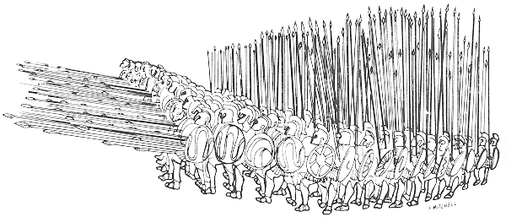
Phalanx
18 foot pike
256 Men
Notes:
The size of the phalanx fielded by Macedon and its various successor states varied greatly. Alexander the Great, for example, fielded 9,000 Foot Companions throughout much of his campaign. These were divided into six, 1,500-man brigades, each from a separate district of Macedon. Phillip V fielded 16,000 phalangites at Cynoscephalae, and Perseus reputedly fielded over 20,000 at Pydna.
These soldiers fought in close-ranked rectangular formations, of which the smallest tactical unit was the 256 men strong syntagma or speira. This formation typically fought eight or sixteen men deep and in a frontage of thirty-two or sixteen men accordingly. Each file of 16 men included two junior officers (one at the head and one at the rear) and a tertiary leader (at the middle of the file). The commander of this unit theoretically fought at the head of the extreme far-right file. According to Aelian, a syntagma was accompanied by five additional individuals to the rear: a herald (to act as a messenger), a trumpeter (to sound out commands), an ensign (to hold the unit's standard), an additional officer (called ouragos), and a servant.

Slide 13
Thracian Maedi (339 B.C.)
Alexander was 16 years old
Philip departed to wage war against Byzantium
Alexander was left in charge as regent of the kingdom
The Thracian Maedi revolted
Alexander responded quickly and crushed the Maedi insurgence driving them from their territory, colonized it with Greeks and founded a city called Alexandropolis

Slide 14
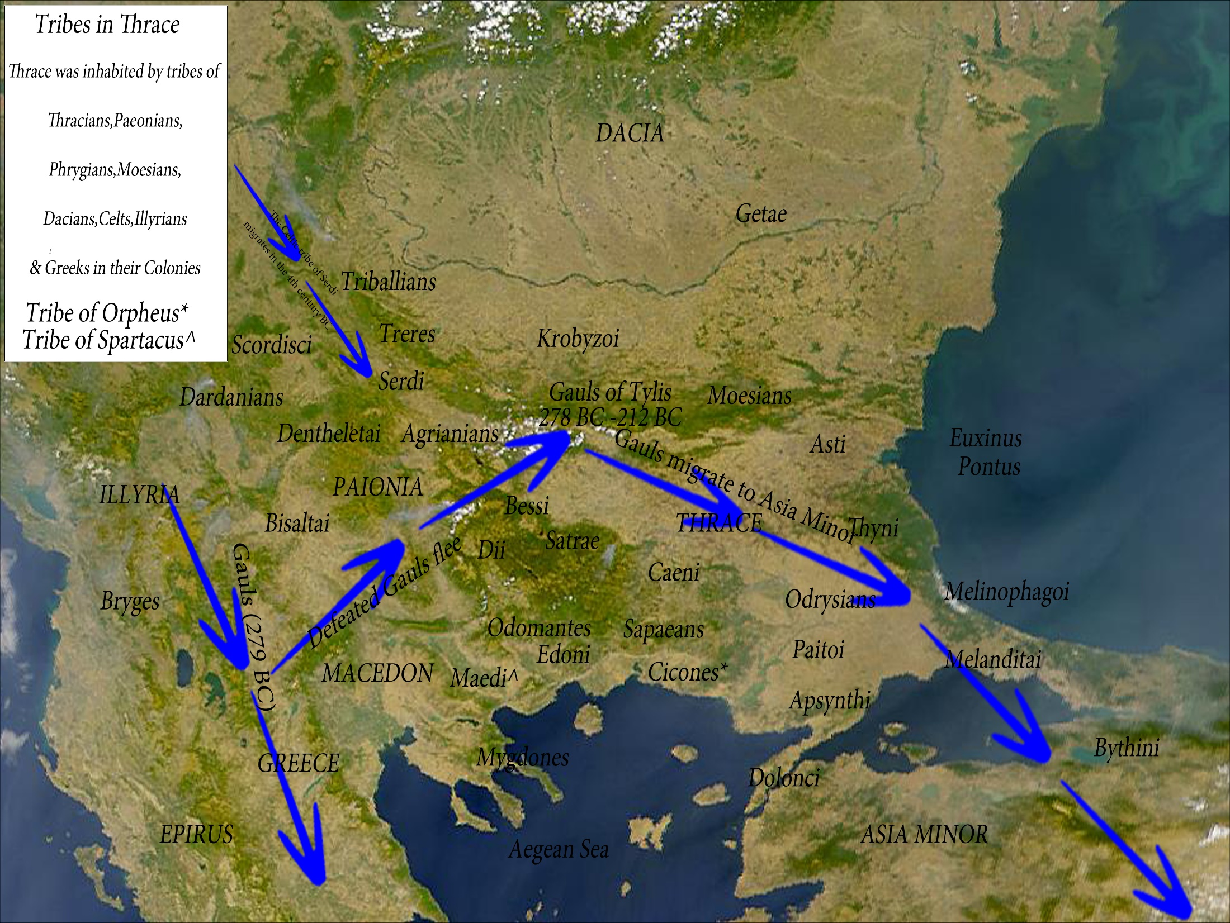

Slide 15
Battle of Issus (333 B.C.)
Darius III of Persia did not take Alexander’s campaign seriously
Alexander intended to “liberate” all of Asia Minor from Persian control
Darius with a large army met Alexander at Issus, near the Cilician Gates
Routed the Persians and captured the royal household
Darius barely escaped with his life
Battle marks the end of Persia’s dominance over the Near East

Slide 16
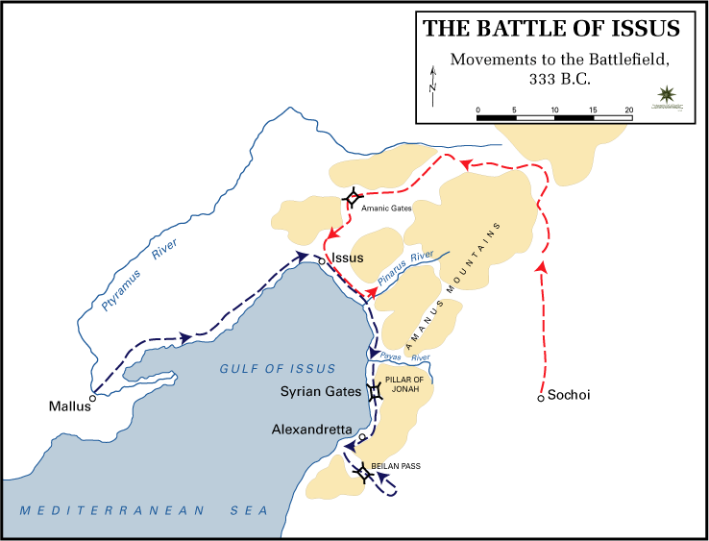
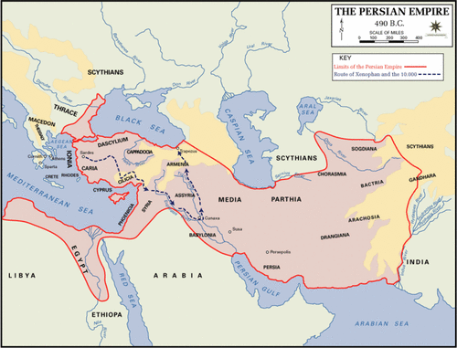

Slide 17
Occupation of Jerusalem (332 B.C.)
In order to protect his southern flank, Alexander marched south to take Palestine and Egypt
Most cities surrendered to him, except Tyre and Gaza
Alexander then spent the winter in Egypt and returned north in the spring of 331
Ordered the building of Alexandria
Jews gained favor under Alexander’s rule
Samaritans tried to share in this favor, but angered Alexander who destroyed Samaria
Notes:
In order to protect his southern flank, Alexander marched south to take Palestine and Egypt. Most cities surrendered to him; he received determined resistance from only two cities: Tyre, which fell after a siege of seven months, and Gaza, which was besieged two months.
Probably during the siege of Gaza Jerusalem surrendered to Alexander. Josephus records a romantic version of this event (Antiquities 11:8:4-5), in which the high priest Jaddua met the young conqueror outside the city and showed him how he fulfilled the prophecy of Daniel (Dan 7:6; 8:5-8, 21; 11:3). (Battle)
Alexander gave good terms to the Jews. According to Jewish tradition, the Samaritans desired to share in their favor; they told Alexander they were Jews, descendents of Joseph. Apparently in 331, as Alexander moved north through Palestine, there was some kind of revolt in
Samaria, and the Greeks destroyed the city. From that time the Samaritans moved their civil and religious center to the ancient city of Shechem.
Josephus: So when Alexander besieged Tyre, he sent an epistle to the Jewish high-priest, to send him some auxiliaries, and to supply his army with provisions; and that what presents he formerly sent to Darius, he would now send to him, and choose the friendship of the Macedonians, and that he should never repent of so doing. But the high-priest answered the messengers, that he had given his oath to Darius not to bear arms against him; and he said that he would not transgress this while Darius was in the land of the living. Upon hearing this answer, Alexander was very angry; and though he determined not to leave Tyre, which was just ready to be taken, yet as soon as he had taken it, he threatened that he would make an expedition against the Jewish high-priest, and through him teach all men to whom they must keep their oaths. So when he had, with a good deal of pains during the siege, taken Tyre, and had settled its affairs, he came to the city of Gaza, and besieged both the city and him that was governor of the garrison, whose name was Babemeses.
But [the Samarian leader] Sanballat thought he had now gotten a proper opportunity to make his attempt, so he renounced Darius, and taking with him seven thousand of his own subjects, he came to Alexander; and finding him beginning the siege of Tyre, he said to him, that he delivered up to him these men, who came out of places under his dominion, and did gladly accept of him for his lord instead of Darius. So when Alexander had received him kindly, Sanballat took courage, and spoke to him about his present affair. He told him that he had a son-in-law, Manasseh, who was brother to the high-priest Jaddus; and that there were many others of his own nation, now with him, that were desirous to have a temple in the places subject to him; that it would be for the king's advantage to have the strength of the Jews divided into two parts, lest when the nation is of one mind, and united, upon any attempt for innovation, it prove troublesome to kings, as it had formerly proved to the kings of Assyria. Whereupon Alexander gave Sanballat leave so to do, who used the utmost diligence, and built the temple, and made Manasseh the priest, and deemed it a great reward that his daughter's children should have that dignity; but when the seven months of the siege of Tyre were over, and the two months of the siege of Gaza, Sanballat died.
Now Alexander, when he had taken Gaza, made haste to go up to Jerusalem; and Jaddus the high-priest, when he heard that, was in an agony, and under terror, as not knowing how he should meet the Macedonians, since the king was displeased at his foregoing disobedience. He therefore ordained that the people should make supplications, and should join with him in offering sacrifice to God, whom he besought to protect that nation, and to deliver them from the perils that were coming upon them; whereupon God warned him in a dream, which came upon him after he had offered sacrifice, that he should take courage, and adorn the city, and open the gates; that the rest should appear in white garments, but that he and the priests should meet the king in the habits proper to their order, without the dread of any ill consequences, which the providence of God would prevent. Upon which, when he rose from his sleep, he greatly rejoiced, and declared to all the warning he had received from God. According to which dream he acted entirely, and so waited for the coming of the king.
And when Jaddus understood that Alexander was not far from the city, he went out in procession, with the priests and the multitude of the citizens. The procession was venerable, and the manner of it different from that of other nations. It reached to a place called Sapha, which name, translated into Greek, signifies a prospect, for you have thence a prospect both of Jerusalem and of the temple. And when the Phoenicians and the Samarians that followed him thought they should have liberty to plunder the city, and torment the high-priest to death, which the king's displeasure fairly promised them, the very reverse of it happened; for Alexander, when he saw the multitude at a distance, in white garments, while the priests stood clothed with fine linen, and the high-priest in purple and scarlet clothing, with his mitre on his head, having the golden plate whereon the name of God was engraved, he approached by himself, and adored that name, and first saluted the high-priest.
The Jews also did all together, with one voice, salute Alexander, and encompass him about; whereupon the kings of Syria and the rest were surprised at what Alexander had done, and supposed him disordered in his mind. However, Parmenion alone went up to him, and asked him how it came to pass that, when all others adored him, he should adore the high-priest of the Jews? To whom he replied, 'I did not adore him, but that God who has honored him with his highpriesthood; for I saw this very person in a dream, in this very habit, when I was at Dion in Macedonia, who, when I was considering with myself how I might obtain the dominion of Asia, exhorted me to make no delay, but boldly to pass over the sea thither, for that he would conduct my army, and would give me the dominion over the Persians; whence it is that, having seen no other in that habit, and now seeing this person in it, and remembering that vision, and the exhortation which I had in my dream, I believe that I bring this army under the Divine conduct, and shall therewith conquer Darius, and destroy the power of the Persians, and that all things will succeed according to what is in my own mind.'
And when he had said this to Parmenion, and had given the high-priest his right hand, the priests ran along by him, and he came into the city. And when he went up into the temple, he offered sacrifice to God, according to the high-priest's direction, and magnificently treated both the high-priest and the priests. And when the Book of Daniel was showed him wherein Daniel declared that one of the Greeks should destroy the empire of the Persians, he supposed that himself was the person intended. And as he was then glad, he dismissed the multitude for the present.
But the next day he called them to him, and bid them ask what favors they pleased of him; whereupon the high-priest desired that they might enjoy the laws of their forefathers, and might pay no tribute on the seventh year. He granted all they desired. And when they asked him that he would permit the Jews in Babylon and Media to enjoy their own laws also, he willingly promised to do hereafter what they desired. And when he said to the multitude, that if any of them would enlist themselves in his army, on this condition, that they should continue under the laws of their forefathers, and live according to them, he was willing to take them with him, many were ready to accompany him in his wars.
So when Alexander had thus settled matters at Jerusalem, he led his army into the neighboring cities; and when all the inhabitants to whom he came received him with great kindness, the Samaritans, who had then Shechem for their metropolis -a city situate at Mount Gerizzim, and inhabited by apostates of the Jewish nation- seeing that Alexander had so greatly honored the Jews, determined to profess themselves Jews [...]. Accordingly, they made their address to the king with splendor, and showed great alacrity in meeting him at a little distance from Jerusalem. And when Alexander had commended them, the Shechemites approached to him, taking with them the troops that Sanballat had sent him, and they desired that he would come to their city, and do honor to their temple also; to whom he promised, that when he returned he would come to them. And when they petitioned that he would remit the tribute of the seventh year to them, because they did but sow thereon, he asked who they were that made such a petition; and when they said that they were Hebrews, but had the name of Sidonians, living at Shechem, he asked them again whether they were Jews; and when they said they were not Jews, 'It was to the Jews,' said he, 'that I granted that privilege; however, when I return, and am thoroughly informed by you of this matter, I will do what I shall think proper.'
And in this manner he took leave of the Shechemites; but ordered that the troops of Sanballat should follow him into Egypt, because there he designed to give them lands, which he did a little after in Thesis, when he ordered them to guard that country.

Slide 18
The “New” Alexander
Alexander declared himself basileus (“king”) and the “son of Ammon” (an Egyptian sun god)
He adopted the clothing and behavior of an Oriental royal leader
Strained the relation between him and his army
He became increasingly cruel
Merciless sack of Persepolis
Notes:
After invading Persia, Alexander the Great sent the main force of his army to Persepolis in the year 330 BC by the Royal Road. Alexander stormed the Persian Gates (in the modern Zagros Mountains), then quickly captured Persepolis before its treasury could be looted. After several months Alexander allowed his troops to loot Persepolis. A fire broke out in the eastern palace of Xerxes and spread to the rest of the city. It is not clear if it had been a drunken accident, or a deliberate act of revenge for the burning of the Acropolis of Athens during the Second Hellenic-Persian War. Many historians argue that while Alexander's army celebrated with a symposium they decided to take revenge against Persians. In that case it would be a combination of the two. The Book of Arda Wiraz, a Zoroastrian work composed in the 3rd or 4th century CE, also describes archives containing "all the Avesta and Zand, written upon prepared cow-skins, and with gold ink" that were destroyed. Indeed in his The chronology of ancient nations, the native Iranian writer Biruni indicates unavailability of certain native Iranian historiographical sources in post-Achaemenid era especially during Ashkanian and adds "..And more than that. He (Alexander) burned the greatest part of their religious code, he destroyed the wonderful architectural monouments in the mountains of Istakhr, nowadays known as the mosque of Solomon ben David, and delivered them up to the flames. People say that even at the present time the traces of fire are visible in some places.“ (Wiki)

Slide 19
Alexander’s Death
Alexander continued to push his troops eastward
Unrestrained expansion of the empire
On the way to the Ganges Valley in India his army refused to go further
Forced finally to start making his way back to Greece
Alexander died in Babylon in 323 B.C. at the age of 32
Died of a “sickness” possibly poison
Notes:
On either 10 or 11 June 323 BC, Alexander died in the palace of Nebuchadnezzar II, in Babylon aged 32. Plutarch gives a lengthy account of the circumstances of his death, echoed (without firm dates) by Arrian. Roughly 14 days before his death, Alexander entertained his admiral Nearchus, and then, instead of going to bed, spent the night and next day drinking with Medius of Larissa. After this, and by the 18th of Daesius (a Macedonian month) he had developed a fever, which then grew steadily worse. By the 25th of Daesius, he was unable to speak. By the 26th, the common soldiers had become anxious about his health, or thought he was already dead. They demanded to see him, and Alexander's generals acquiesced. The soldiers slowly filed past him, whilst Alexander raised his right hand in greeting, still unable to speak. Two days later, on the 28th of Daesius (although Aristobolus's account says it was the 30th), Alexander was dead. Conversely, Diodorus recounts that Alexander was struck down with pain after downing a large bowl of unmixed wine in honour of Hercules, and (rather mysteriously) died after some agony, which is also mentioned as an alternative by Arrian, but Plutarch specifically refutes this claim.
Possible causes
Poison
Given the propensity of the Macedonian aristocracy to assassination, it is scarcely surprising that allegations of foul play have been made about the death of Alexander. Diodorus, Plutarch, Arrian and Justin all mention the theory that Alexander was poisoned. Plutarch dismisses it as a fabrication, whilst both Diodorus and Arrian say that they only mention it for the sake of completeness. The accounts are nevertheless fairly consistent in fingering Antipater, recently removed from the position of Macedonian viceroy, and at odds with Olympias, as the head of the alleged plot. Perhaps taking his summons to Babylon as a death sentence in waiting, and having seen the fate of Parmenion and Philotas, Antipater arranged for Alexander to be poisoned by his son Iollas, who was Alexander's wine-pourer. There is even a suggestion that Aristotle may have had a hand in the plot. Perhaps the strongest argument against the poison theory is the fact that twelve days had passed between the start of his illness and his death; in the ancient world, such long-acting poisons were probably not available.
Natural causes
Several diseases have been suggested as the cause of Alexander's death; malaria or typhoid fever are obvious candidates. A 1998 article in the New England Journal of Medicine attributed his death to typhoid fever complicated by bowel perforation and ascending paralysis, whereas another recent analysis has suggested pyrogenic spondylitis or meningitis as the cause. Other illnesses could have also been the culprit, including acute pancreatitis or the West Nile virus. Another theory is that Alexander may have died as a result of overdosing on Hellebore, a plant at that time used medicinely, but deadly in large doses. Natural cause theories also tend to emphasise that Alexander's health may have been in general decline after years of heavy drinking and suffering severe wounds (including one in India that nearly claimed his life). Furthermore, it has also been suggested that the anguish that Alexander felt after Hephaestion's death may have contributed to his declining health. (Wiki)

Slide 20
Division of the Greek Empire
Diadochoi; it is the title given to the Greek generals who carved up Alexander’s empire among themselves after his death
One of them, Cassander, murdered Alexander’s widow and his infant son
After seven years of fighting, four men emerged as the most powerful:
Antigonus (Mediterranean Sea to Asia)
Ptolemy Lagi (Egypt and south Syria)
Cassander (Macedonia)
Lysimachus (Thrace)

Slide 21
Further Division
In 312 B.C. the other three Diadochoi contained the overambitious Antigonus
In 311 B.C. Ptolemy’s General Seleucus split off on his own and established himself as ruler of Babylon and Syria
Four rulers still remained (Dan 7:6; 8:8; 11:4)
Of special importance to Jewish history:
Ptolemies in Egypt
Seleucids in Syria
Palestine became a political football between these competing powers

Slide 22
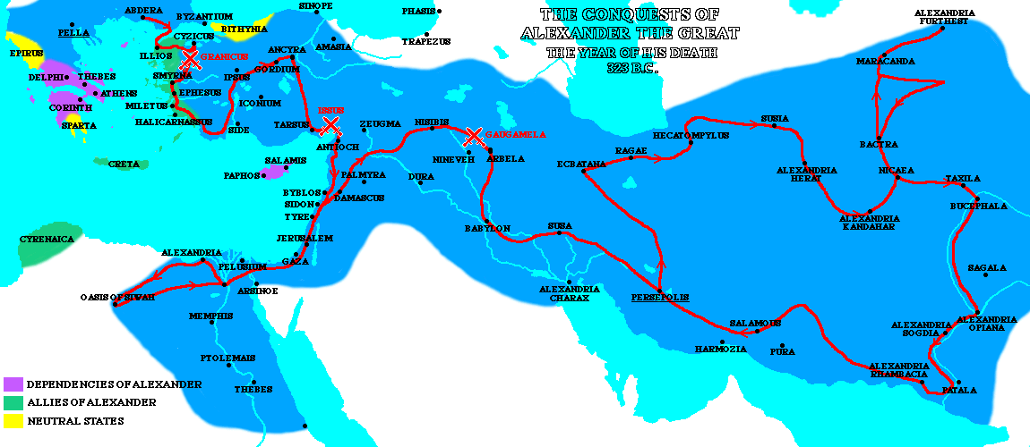
Route of Alexander’s March

Slide 23
Alexander’s Influence on Jews
Ruled over a further degeneration of the relationship between Jews and Samaritans
Does not destroy the Temple as requested by the Samaritans
Jewish history states that Alexander gives Jews freedom to worship God
Jews continue to flourish as a separate and distinct entity for 165 years
Jews - with the exception of a small minority - reject Hellenism, Greeks grow intolerable and the Greek culture infects Judaism
Notes:
They (the Jews led by Shimon HaTzaddik) answered, "Is it possible that these idol worshippers (Samaritans) should fool you into destroying the House where prayers are offered for you and your kingdom that it should never be destroyed!" Alexander said to them, "What idol worshippers do you mean?" They replied, "We are referring to the Samaritans who are standing before you now." Said Alexander, "I am handing them over to you to do with them as you please."

Slide 24
Review
Reviewed last week’s lesson
Reviewed the transition of power between Persians and the Greeks
Reviewed key Biblical scriptures
Learn about the political, social, economic, cultural, and religious issues during the Greek rule over Israel
Learn about Alexander's impact on the Mediterranean and Asian regions
Learn about the transition of the Greek empire
Next week – Ptolemaic Empire
Notes:
24

